Slide 1
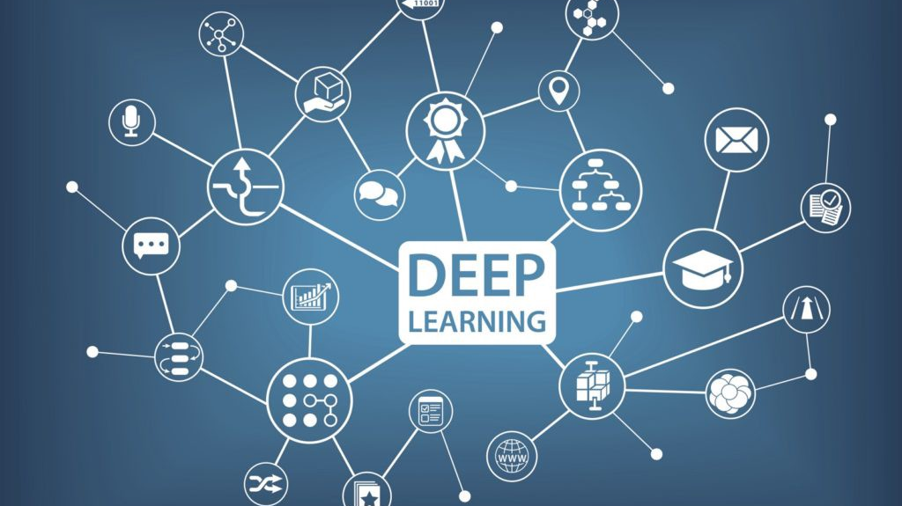
Deep Learning for Sentiment Analysis

Slide 2

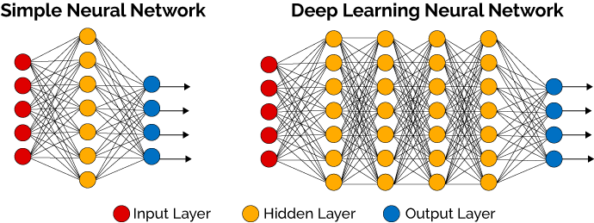

What is Deep Learning ?
Deep Learning is a subfield of machine learning concerned with algorithms inspired by the structure and function of the brain called artificial neural networks.
There are different types of DL models. The main of them are -
Convolutional Neural Network.
Recurrent Neural Networks (RNN).
Long Short-Term Memory (LSTM).
Restricted Boltzmann Machine (RBM).

Slide 3
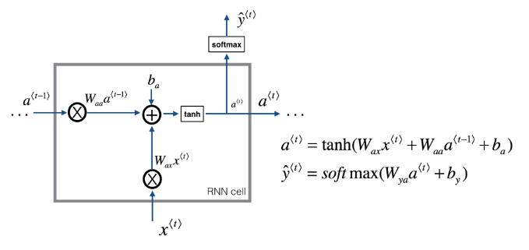
What is RNN ?
Recurrent neural network (RNN) is a type of deep learning model that is mostly used for analysis of sequential data (time series data prediction).
There are different application areas that are used: Language model, neural machine translation, music generation, time series prediction, financial prediction, etc.
The aim of this implementation is to help to learn structure of basic RNN.

Slide 4
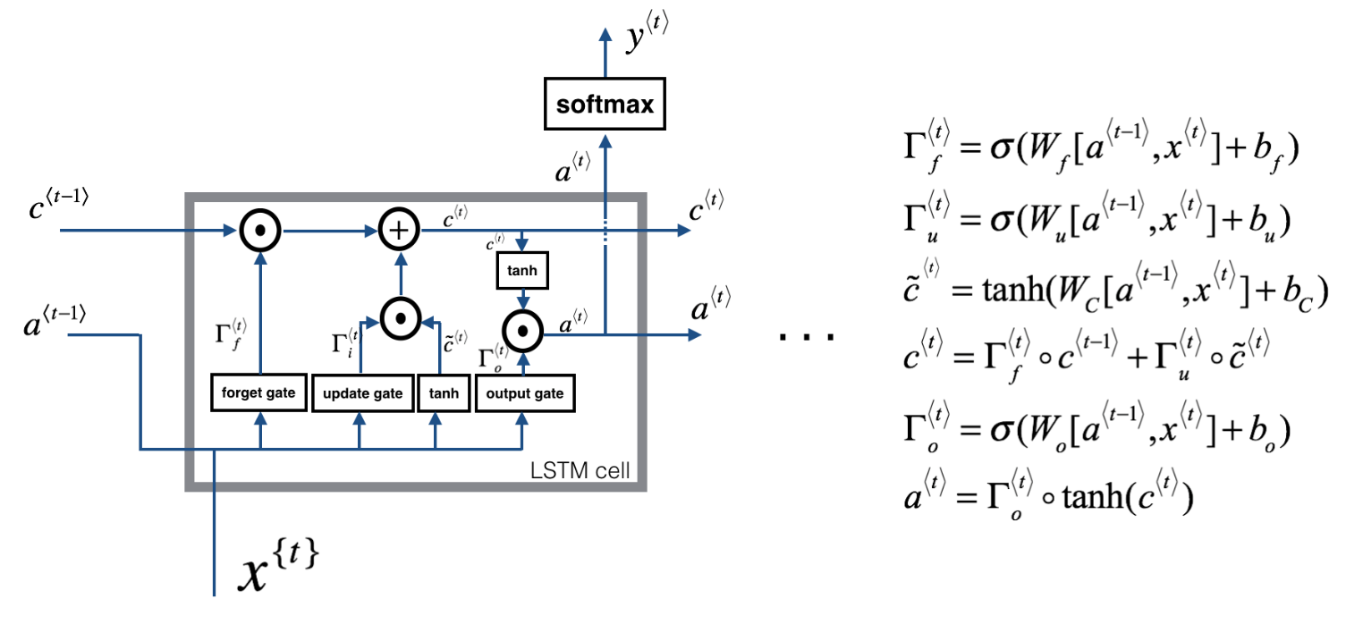
What is LSTM?
It is a special type of RNN, capable of learning long-term dependencies.
Long short-term memory (LSTM) units are units of a recurrent neural network (RNN). An RNN composed of LSTM units is often called an LSTM network. A common LSTM unit is composed of a cell, an input gate, an output gate and a forget gate. The cell remembers values over arbitrary time intervals and the three gates regulate the flow of information into and out of the cell.

Slide 5
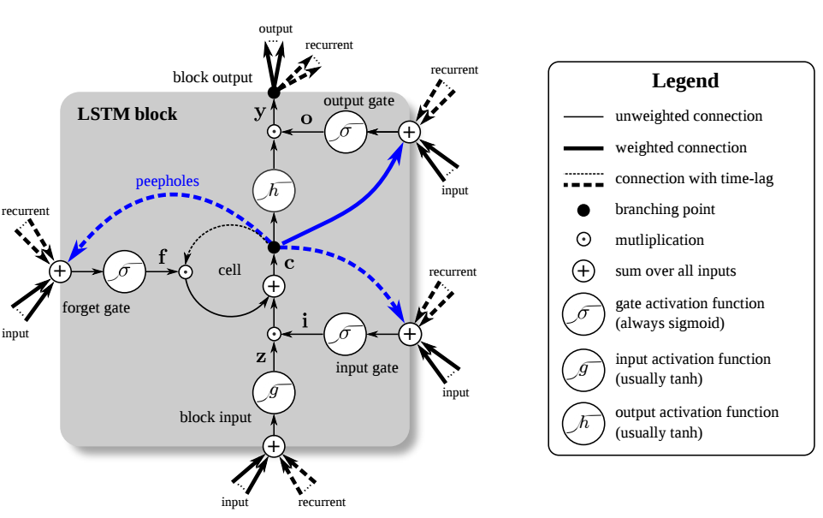
What is LSTM ?
Long Short-Term Memory (LSTM) is a type of deep learning model that is mostly used for analysis of sequential data (time series data prediction).
There are different application areas that are used - Language model, Neural machine translation, Music generation, Time series prediction, Financial prediction, Robot control, Time series prediction, Speech recognition, Rhythm learning, Music composition, Grammar learning, Handwriting recognition, Human action recognition, Sign Language Translation, Time series anomaly detection, Several prediction tasks in the area of business process management, Prediction in medical care pathways, Semantic parsing, Object Co-segmentation.

Slide 6

RELU
The RelU (Rectified Linear Unit) is an activation function that doing linear operation on the feature map. Furthermore, It transfers negative values to 0.
According to the picture, z is the input of the Neuron.
The Formula Is –
$$f\left(z\right)=\left\{\begin{aligned}0 for z<0 \\ z for z≥0\end{aligned}\right.$$
The Range is - $[0,∞]$

Slide 7

Softmax function
The Softmax function takes a vector as input that consist of K real numbers and normalizes it into a probability distribution consisting of K probabilities.
Some of values can be negative in the vector, but after using the SoftMax function all numbers in the vector will be in range 0 to 1. We will explain it as a probability (as close as to 1 have higher probability).
Furthermore, if the input consist big numbers this numbers will give the highest probability in output.
We used The Softmax function to map the non-normalized input of network to a probability distribution over predicted output classes.

Slide 8
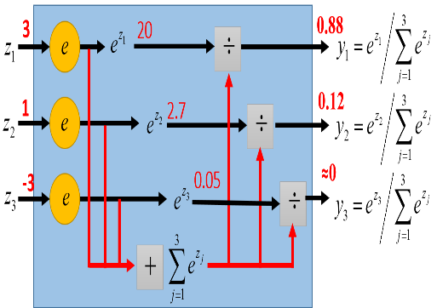
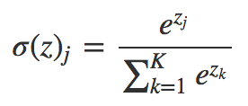
Softmax function
Softmax function calculates the probabilities distribution of the event over ‘n’ different events.
The output of the Softmax will be in the range of 0-1.
The sum of all probabilities will be equal to one.
Used in multiple classification logistic regression model.
In building neural networks Softmax functions used in different layer level.
The highest value will get the highest probability.

Slide 9

Tensor Flow
TensorFlow is an open source software library for numerical computation using data flow graphs.
The graph nodes represent mathematical operations, while the graph edges represent the multidimensional data arrays (tensors) that flow between them. This flexible architecture enables you to deploy computation to one or more CPUs or GPUs in a desktop, server, or mobile device without rewriting code.
TensorFlow also includes Tensor Board, a data visualization toolkit.

Slide 10

SGD optimizer
Stochastic gradient descent (SGD). is an iterative method for optimizing an objective function with suitable smoothness properties.
It is called stochastic because the method uses randomly selected (or shuffled) samples to evaluate the gradients, hence SGD can be regarded as a stochastic approximation of gradient descent optimization.

Slide 11
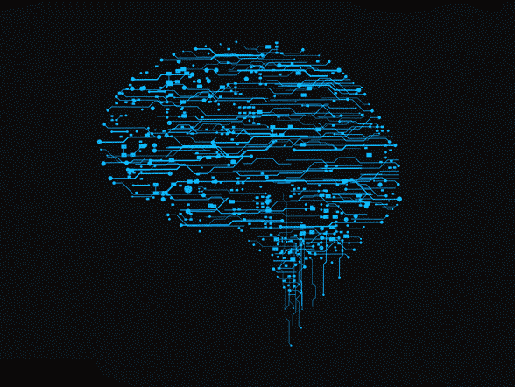
Deep neural network (DNN)
A deep neural network (DNN) is an artificial neural network (ANN) with multiple layers between the input and output layers.
The DNN finds the correct mathematical manipulation to turn the input into the output
The network moves through the layers calculating the probability of each output.
The user can review the results and select which probabilities the network should display (above a certain threshold, etc.) and return the proposed label.
DNN have many layers, hence the name "deep" networks.

Slide 12

Sentiment Analysis - Libraries
The Libraries that we use in our code is –
Numpy – For mathematical operations.
Pandas – For statistics, analytics operations.
TensorFlow – For Deep learning with Neural networks.
Tflearn – For deep learning. It was designed to provide a higher-level API to TensorFlow in order to facilitate and speed-up experimentations.
Collections – For List, Tuple, Dictionary, Etc…

Slide 13
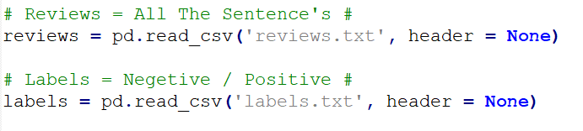
Sentiment Analysis – Data , Sentiment Types
The data in the code include 25,000 sentences.
The sentiment in the code include two types –
Positive Sentiment.
Negative Sentiment.

Slide 14
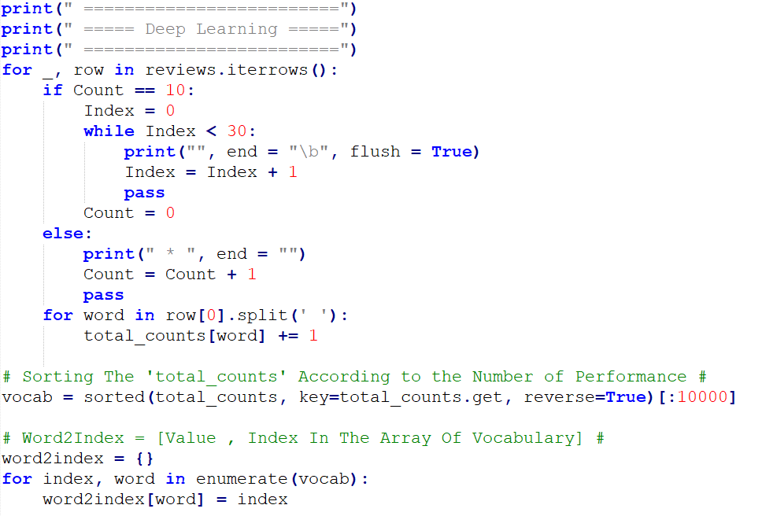
Sentiment Analysis – Code
First, we Count the Frequencies of each word in our data.
Second, we make reverse sorting according the frequencies of each word. The sorting is from the max frequency word to the min frequency word.
Third, we create dictionary that each key is word , and each value is the index that the word located in the sorting list.

Slide 15
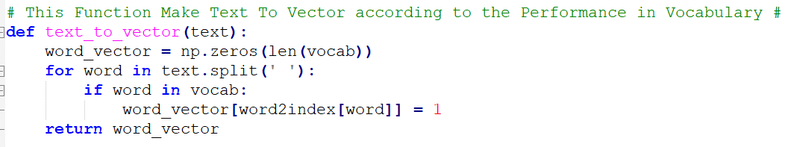
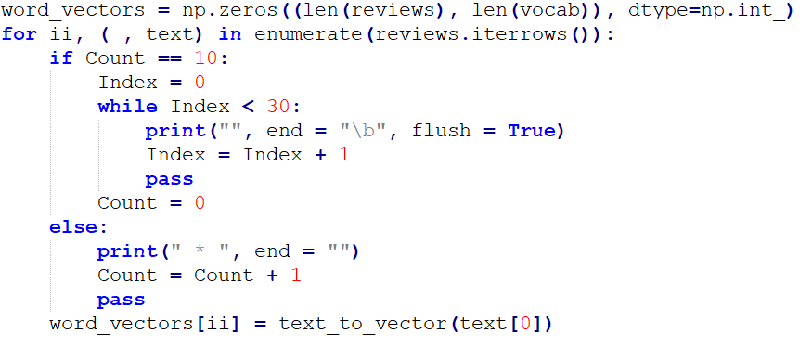
Sentiment Analysis - Code
In this section, we convert each sentence in our data to vector that include zero, or one.
In each sentence, we iterate on his words, and check if the sorted list contains the words of the current sentence in the loop.
If the sorted list contains the current word, we gave to the current word the value “1”, else we gave to the current word the value “0”.

Slide 16
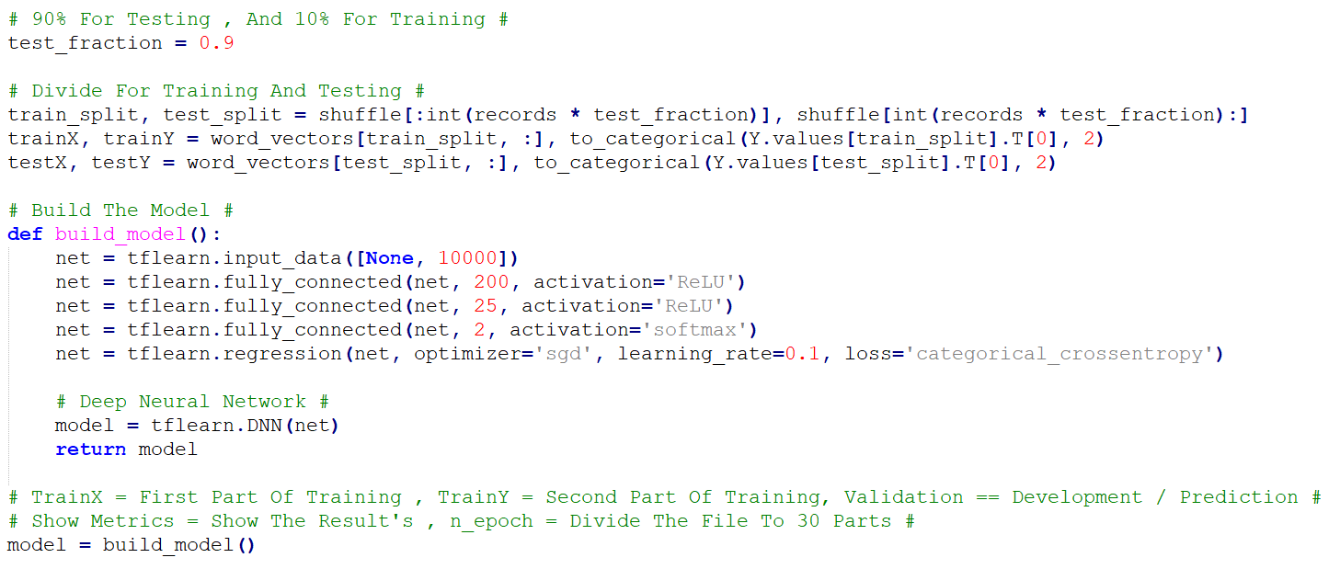
Sentiment Analysis – Building The Model
In this Section, we divide our data to testing , and training.
90% of our data will be testing, and 10% of our data will be training.
After we finish to divide our data, we build our model by activation functions of – RelU, Softmax. Also, we use with SGD optimizer, And finally, we build our model with Deep Neural Network.

Slide 17
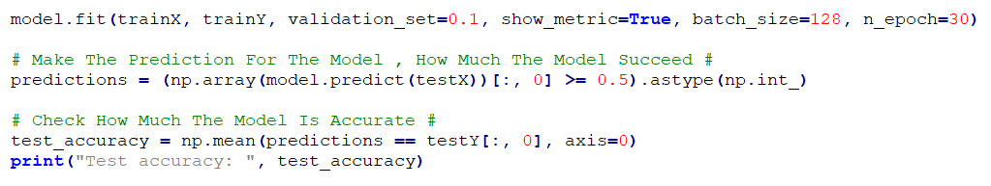
Sentiment Analysis – Train, Test, Predict
In this section, we train our model according to the training, and testing sections.
After we finish to train the model, we make prediction according to the result of the model.
The output of the model include two things –
The accuracy of the model.
File that include the sentences who labels as Positive sentiment.
File that include the sentences who labels as Negative sentiment.

Slide 18
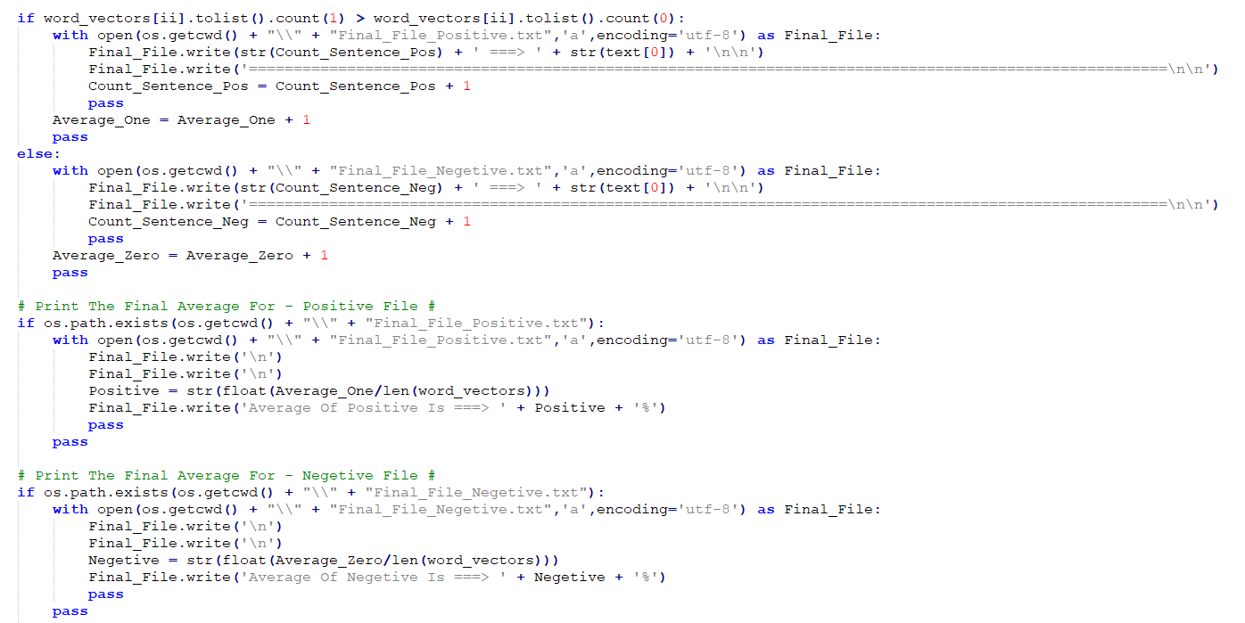
Sentiment Analysis – output files
In this section, as we mentioned before, we create two files –
First file include all the sentences that labels as Positive sentiment by the model.
Second file include all the sentences that labels as Negative sentiment by the model.

Slide 19
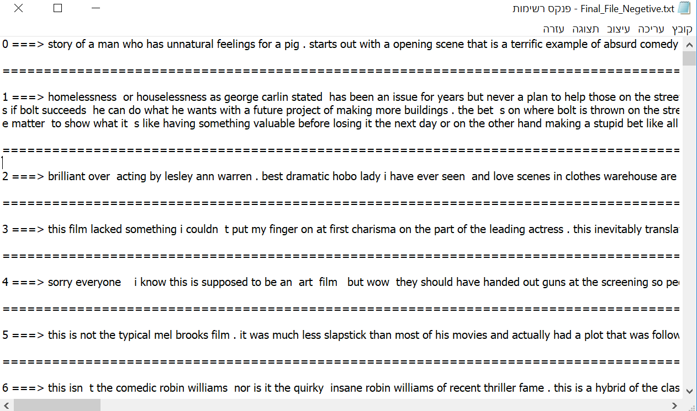
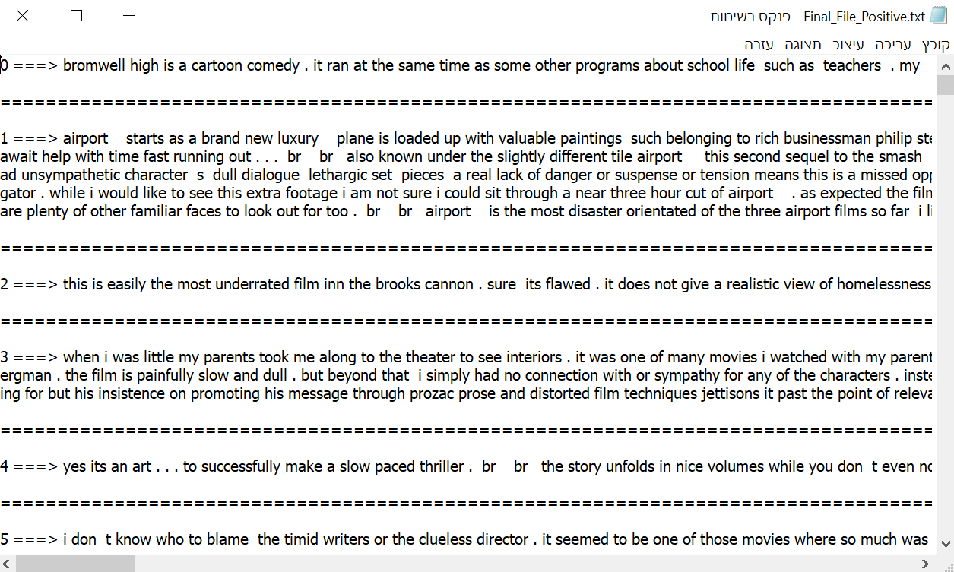
Sentiment Analysis – output files
Negative Sentiment File
Positive Sentiment File

Slide 20
Thanks Din, Aviv, roni ☺

